Slide 1
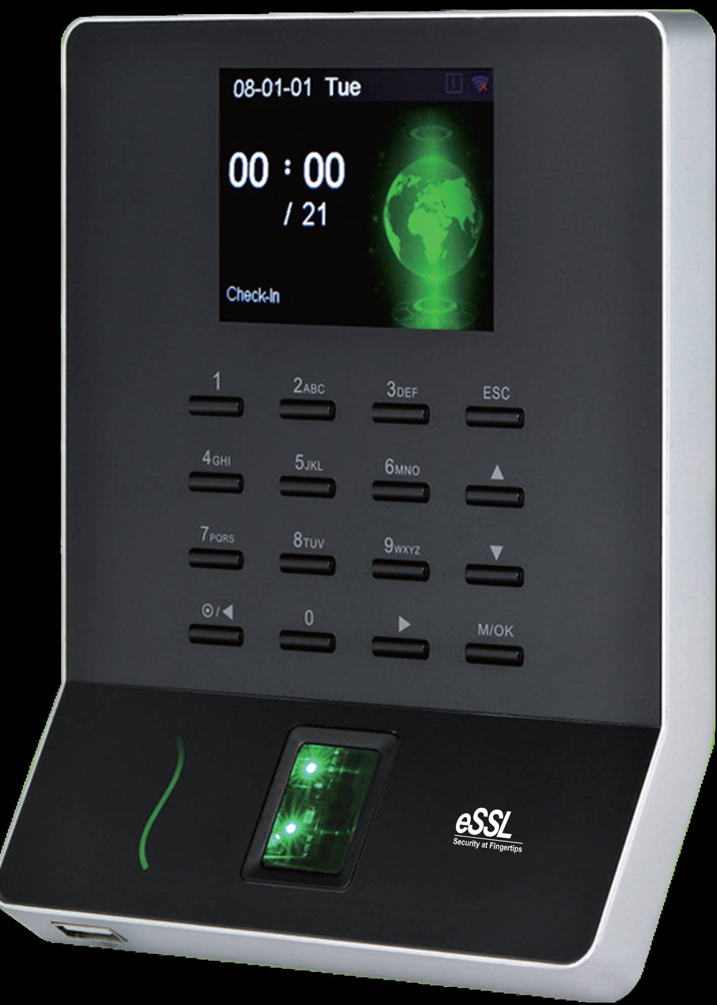
Automatic Attendance System
An overview of the project details, technology, AI agent, use cases, testing details, project timeline, and conclusion of the Automatic Attendance System.

Slide 2
Team Mates
Reddibhathuni Ruchitha - Tech Lead
Yedukondalu Annangi
Rahul Esiripally
Sai Nandini Kandula
Narasimha Reddy Boddapati
Chinnari Vanukuri

Slide 3
Features
Online Attendance Tracking
Adding Students or Course Calendar
Real-Time Monitoring
Providing records in PDF to the faculty
Notifications & Alerts
Access to Faculty to update Attendance

Slide 4

Preliminary Scope of the Project
1
Objectives 🎯
Create a seamless attendance-logging process for students, eliminate the need for manual entry, and automatically log every student.
2
Future Scope:
Data Management
Integrating with Existing Systems
Mobile App
Analysis
3
Target User Base
👥
Any University/ College professors, School teachers, and business owners that have attendance-logging requirements.

Slide 5
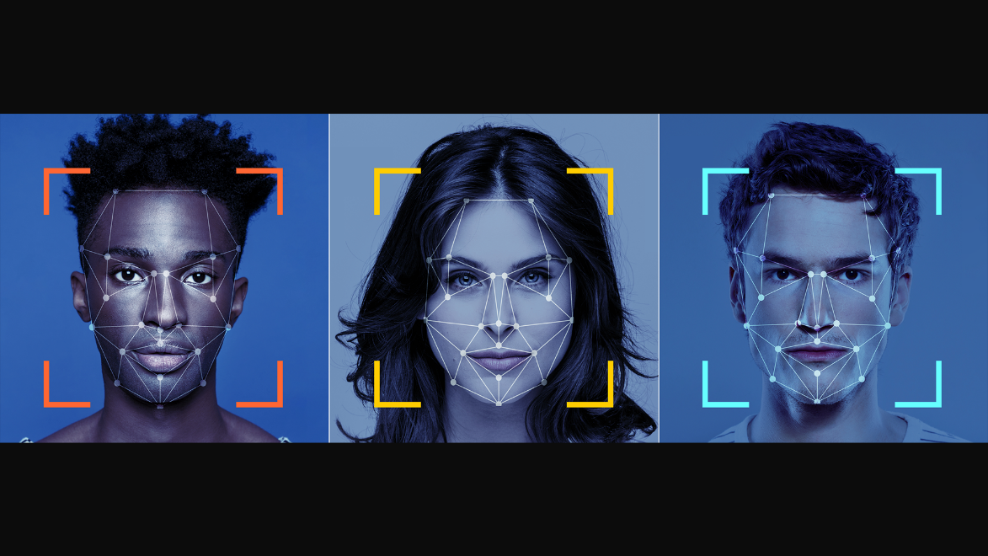
Technology to Be Used
Facial Recognition
We will use facial recognition technology by using CNN to identify the students by their face and log their attendance.

Slide 6
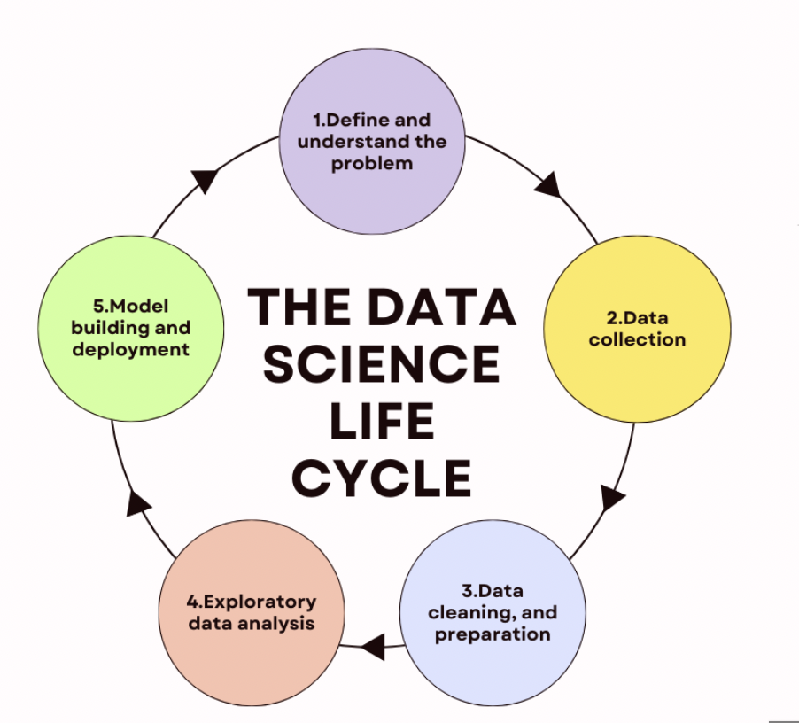
Technical Approach
Data Collection
First, we need to create an image dataset and collect images of all the students in the class and images are extracted from the different sources and combined to form a dataset based on the image labels.
Facial Recognition with Advanced CNN models
Alexnet
VGG
Data Science Life cycle
Deployment
AWS - S3
Google Cloud Platform

Slide 7
AI Agent Details
Agent Name: Vikram🤖
AI Agent will be the brain of the Automatic Attendance System.
Cognitive Skills:
FacialRecognition CNN
Machine learning
Features:
Real-time attendance tracking
Data analysis and reporting

Slide 8
Use Cases for Project Evaluation
1 2
3
University/College 🎓
The system will be evaluated by the faculty of a university/college on the speed, accuracy, and effectiveness of the automatic attendance system in a large classroom.
Schools
The system will be evaluated by schoolteachers on how the technology helps streamline attendance reports, reduce errors, and save time.
Businesses 🏢
The system will be evaluated by a client's business to test how accurately and quickly the system logs employee attendance and tracks productivity.

Slide 9
Testing Procedures
Scenario 1 🎭
Testing the facial recognition technology with students or employees with and without masks.
Scenario 3 🎭
Test if the student is sitting in the assigned classroom
Scenario 2🎭
Testing the effectiveness of AI Agent in tracking attendance over a week.
Scenario 4 🎭
Testing the data reporting system, and the speed and accuracy of attendance reports.

Slide 10
Project Timeline
Project Initiation & Planning 2 Weeks
Development of System Features | 1 Months
Testing and Quality Assurance | 2 Weeks
Deployment and Launch | 2 Weeks

Slide 11


